Slide 1

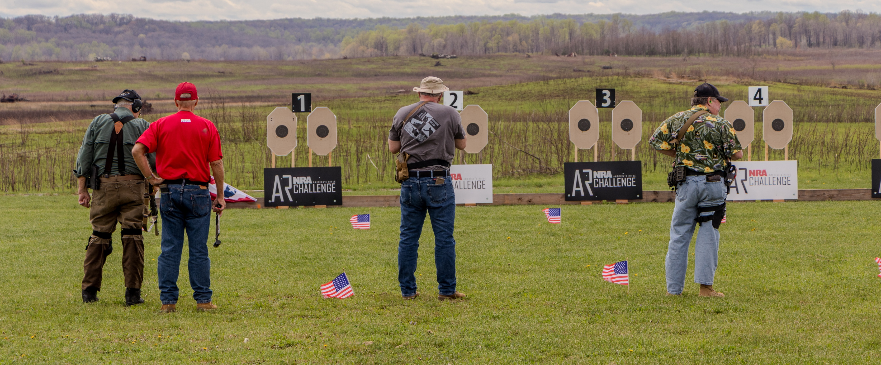

An NRA Competition
and Training Program
For Your Range
Exercise Your Rights Through Competition

Slide 2

The NRA America's Rifle Challenge (ARC) is a competitive shooting and training program focusing on the AR platform.
This program provides multiple levels of competition and training, suitable for AR owners with beginner through expert skill levels categorized in three different divisions of Stock, Limited, and Open. Most responsible owners have firearms that meet one or more division requirements.

Slide 3
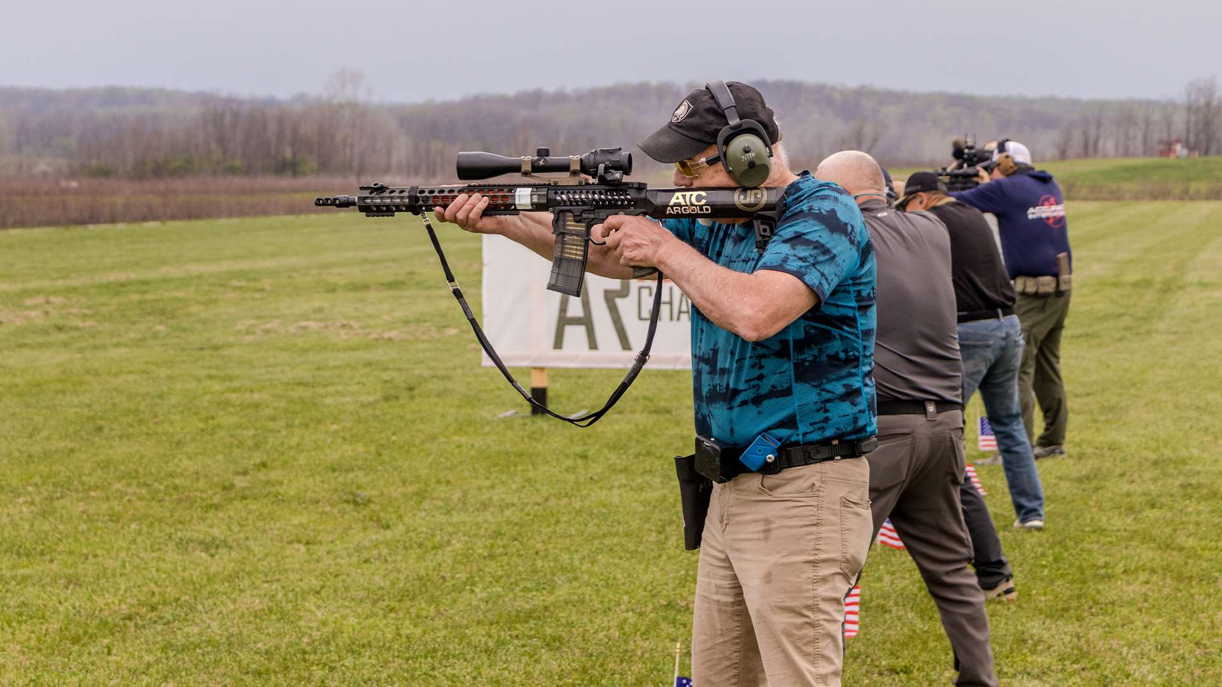

The NRA ARC program includes:
  Club, postal, state, regional and national matches
  Level 1 & 2 training courses
  Classifications and awards
  Suppressors allowed where legally permitted
NRA ARC is designed to:
  Provide competition and training for responsible AR owners
  Increase active participation at clubs and ranges
  Generate revenue for the host

Slide 4
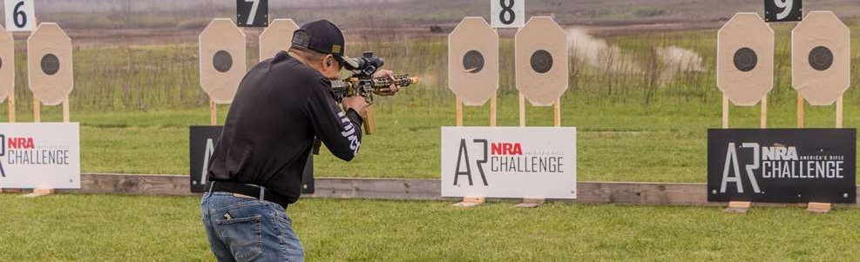
ARC Level I specifics
Level 1 is a challenging fundamentals and skill builder match, fired from 10 to 100 yards over four standardized stages *Reduced range targets allow for hosting ARC Level 1 at facilities with only 25-yard indoor or outdoor ranges
Only 100 rounds per competitor are needed
Fired shoulder to shoulder to maximize number of participants
Centerfire, PCC, and Rimfire are permitted
Minimal match setup, teardown, and easy scoring using Practiscore

Slide 5
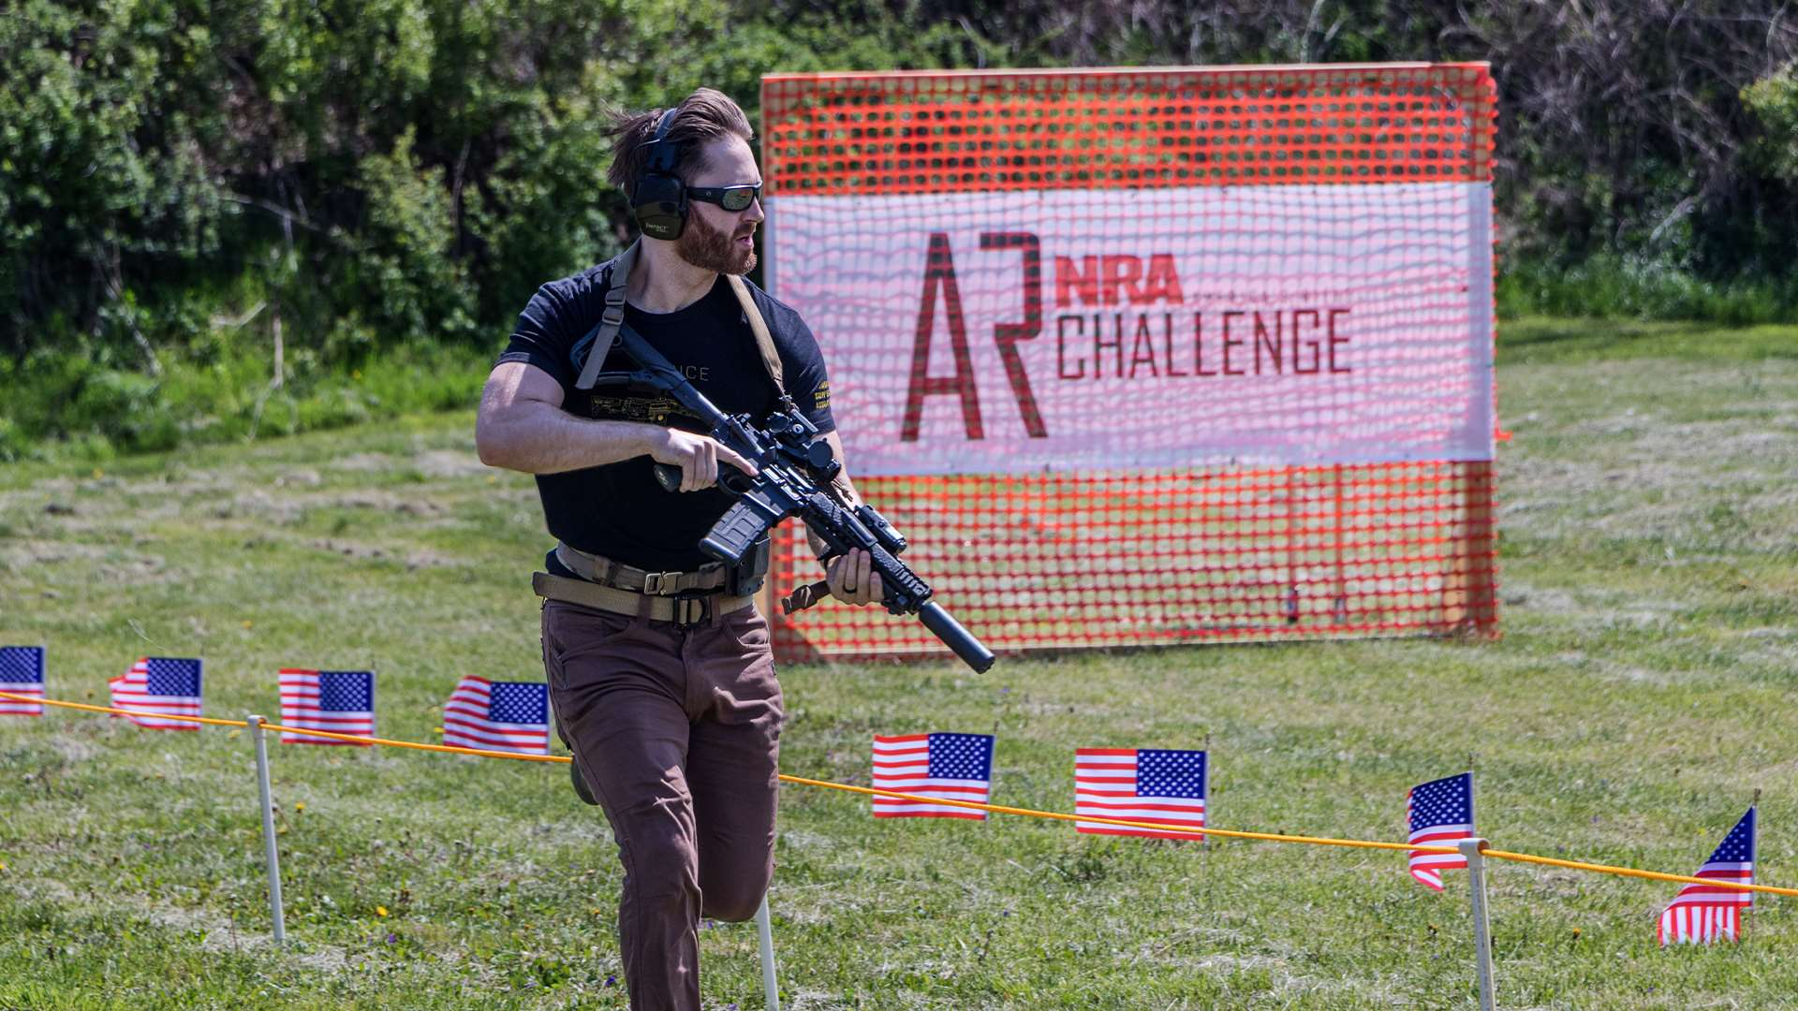
ARC Level 2 specifics
Dynamic and creative stages
Similar set up and management to other squadded action shooting sports
Distances from contact out to 400 yards
Conducted on natural terrain, flat bays, or indoor ranges
Positional, movement, and precision shooting skills required
Cardboard, steel, and reactive targets

Slide 6
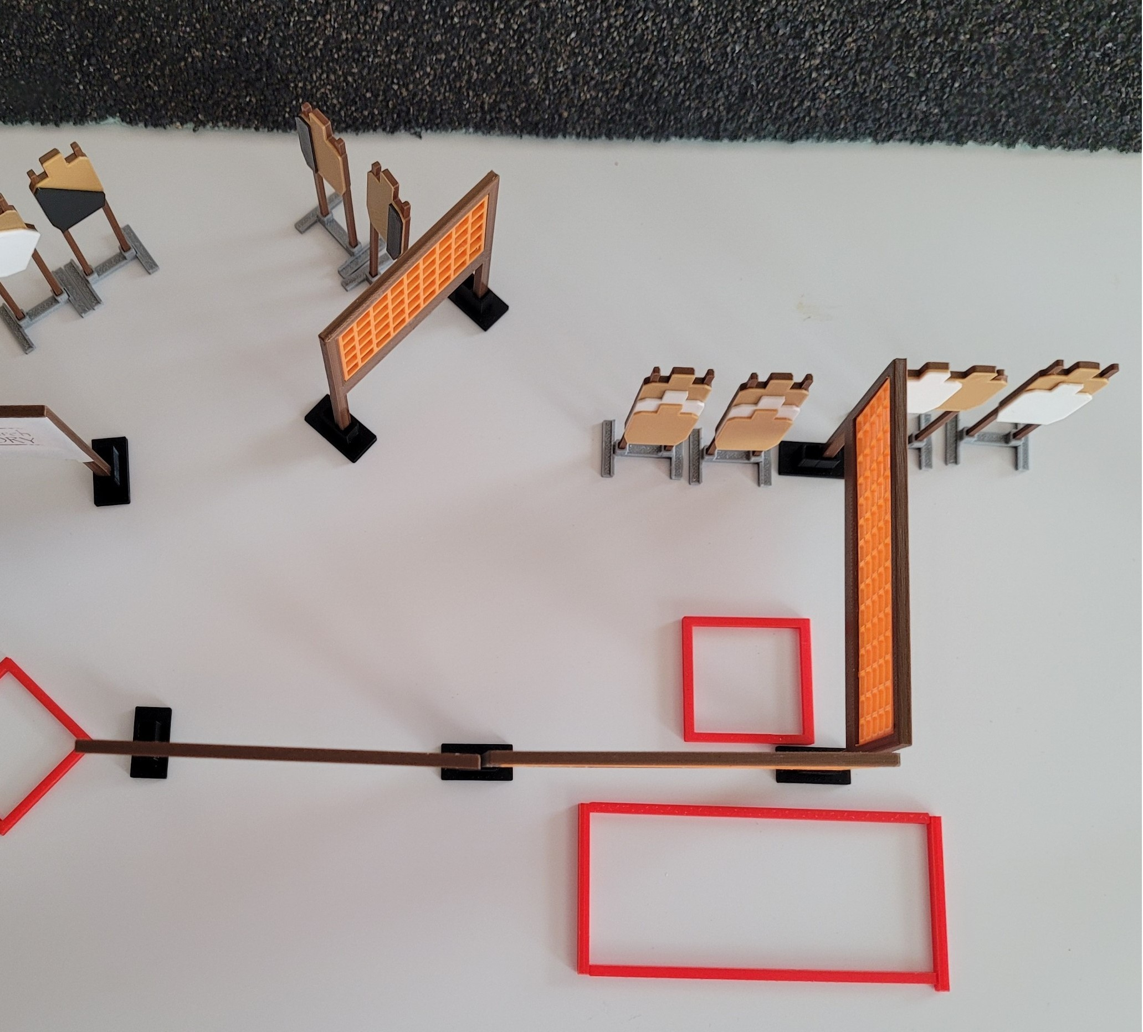
ARC Level 2
Indoor stage example
Creative local designs to meet your club’s range requirements and goals of participants
Items used: Simple walls (hanging or freestanding), target stands and shooting boxes

Slide 7
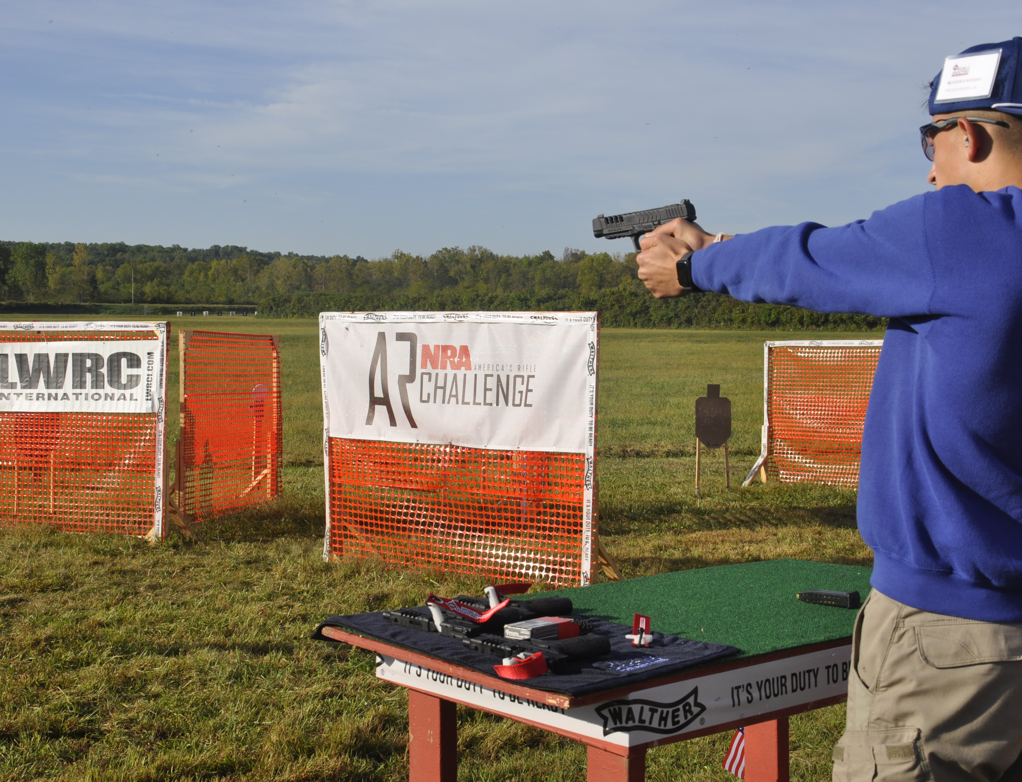
ARC 2Gun
specifics
Multi-gun match testing foundational marksmanship incorporating both rifle and pistol platforms
Uses the same rule-set and format as ARC Level 2 matches
Local control of stage designs to meet your range needs

Slide 8
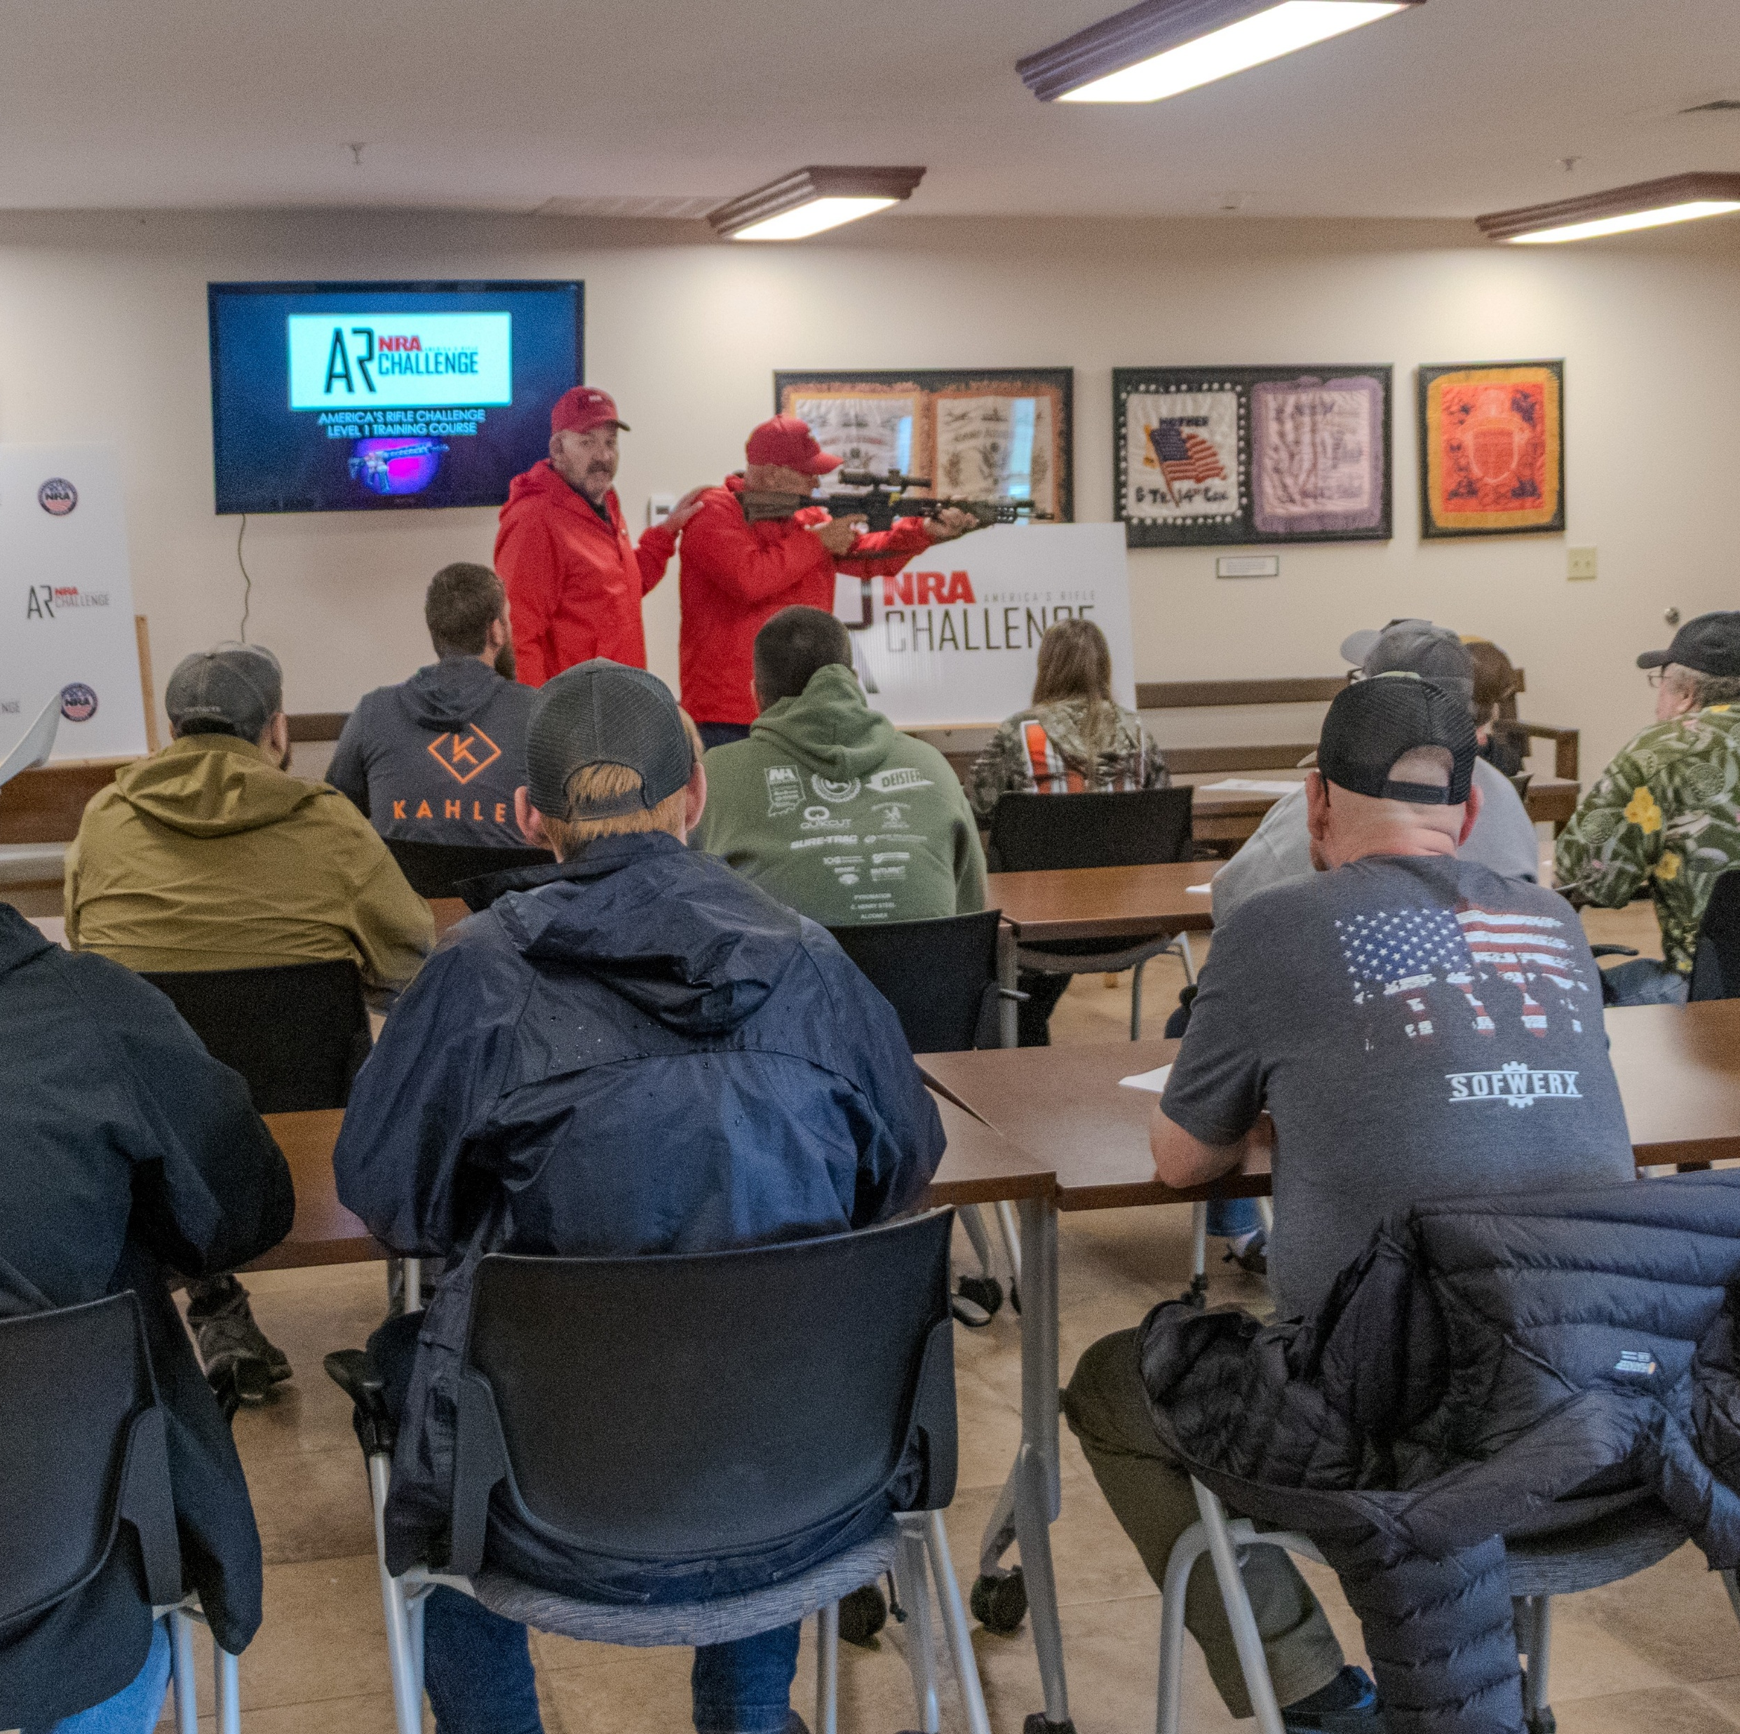
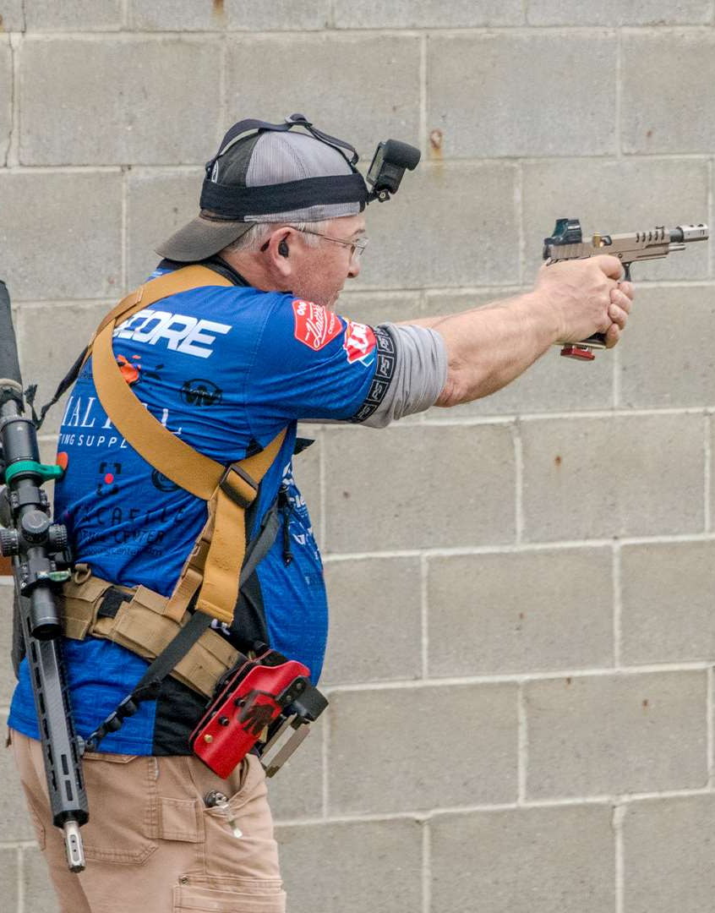
ARC Level 1 & 2 Training
Training courses designed for beginner and intermediate-skilled AR owners in small group classroom settings followed by live fire range exercises
Presented by club appointed instructors
Clubs establish the fee structure
NRA student packages and lesson plans expected to be available soon
ARC Level 2 training lesson plans are being planned for future development

Slide 9
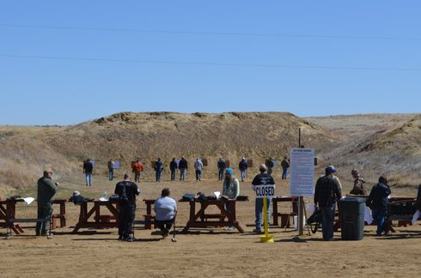
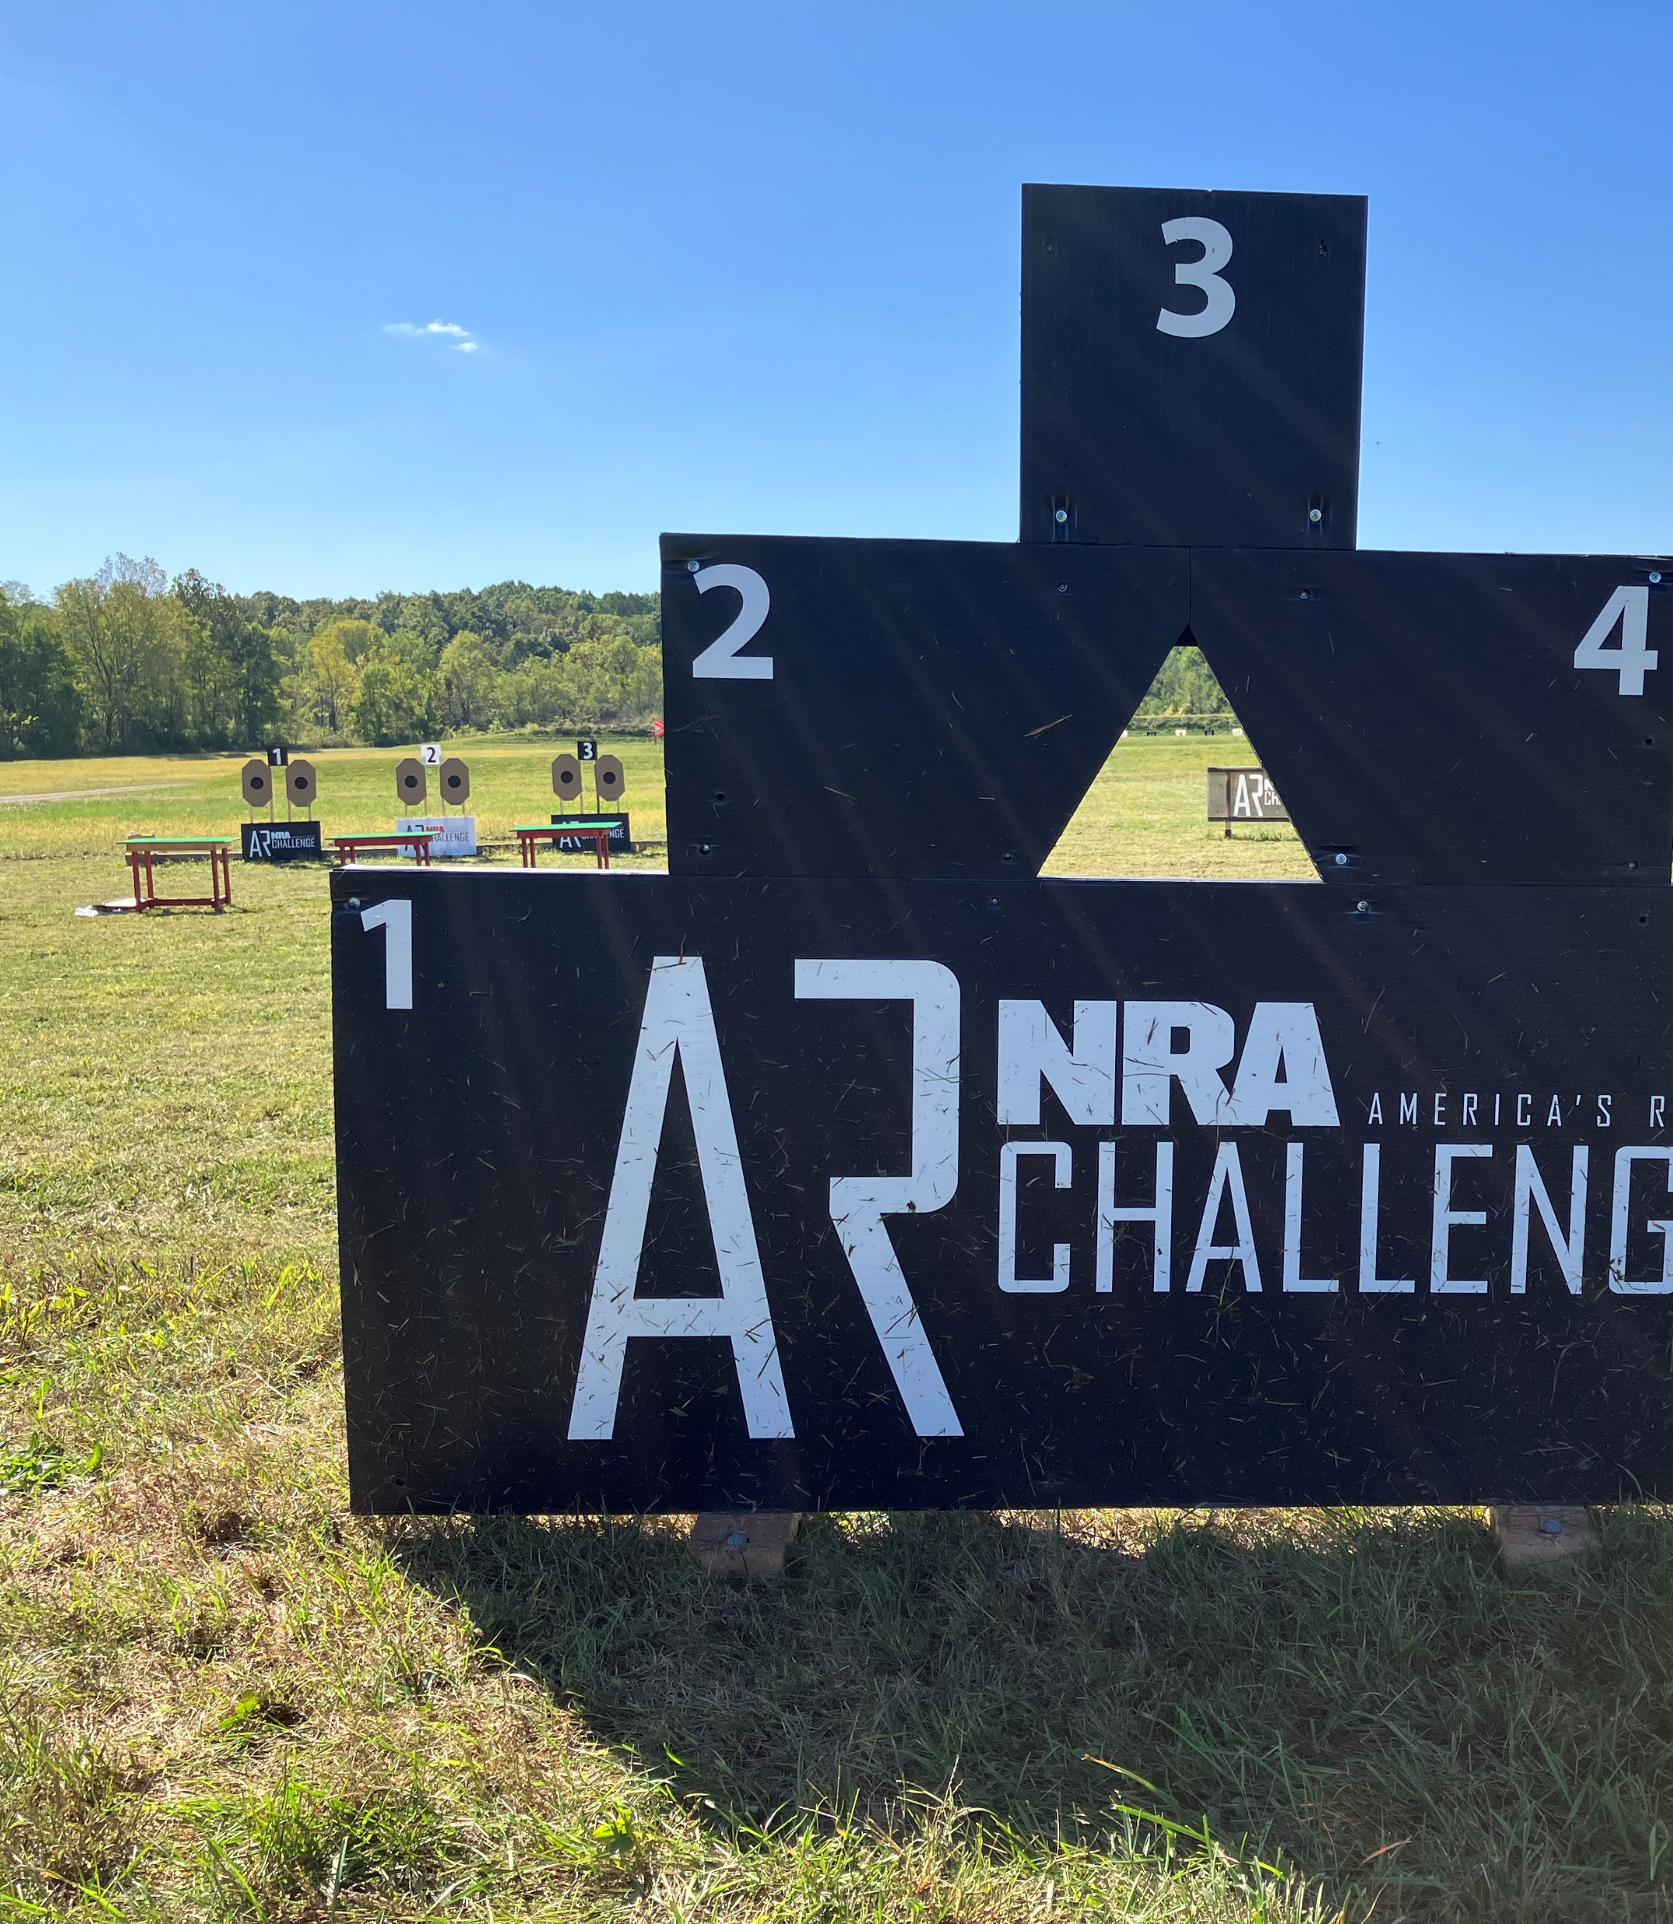
What Do Participants Need?
A Carbine Rifle in one of the following three calibers: .223, .308, or 300BLK. Pistol Caliber Carbines or semi-auto handguns are allowed in 9mm, .40, and .45. Firearms must fit into one of the three divisions: Stock, Limited or Open (see rulebook for division requirements)
A sling for your carbine for all matches and a belt mounted holster for 2Gun
An Empty Chamber Indicator (ECI)
A minimum of four rifle magazines
Hearing and eye protection
Optional use of suppressors & short barrel rifles where legally permitted

Slide 10
This program attracts new and existing firearm owners to your club
You select the ARC match types and training that fit your club and customers
ARC provides a financial benefit to your club, when done efficiently
Provides innovative recreation for your club members and local shooting enthusiasts
ARC training and education courses for Level I & 2 increases revenue for your club
Your club’s range safety will be enhanced as knowledge, skills and abilities increase
Your club will be supporting freedom and the 2nd Amendment, while firmly establishing the AR as a “commonly owned and used firearm”
How NRA ARC Benefits Your Club

Slide 11

A host facility with a minimum of a 25-yard range, indoor or outdoor
A free Practiscore account for your club, allows your club to fully manage events while providing participants a way to find, register, and pay https://practiscore.com/
Electronic shot timer and a scoring tablet such as an iPad or Kindle
NRA ARC Targets, currently available from the National Target Company https://nationaltarget.com/
NRA ARC Barricade and a 12” Rifle Grade Steel Plate. A paper target may be used where steel is not permitted nra_arc_barricade_plans.pdf
A free NRA competitor portal account to submit Tournament Applications and score reports https://competitor.nra.org/
What’s Required From The Host Club or Range?

Slide 12
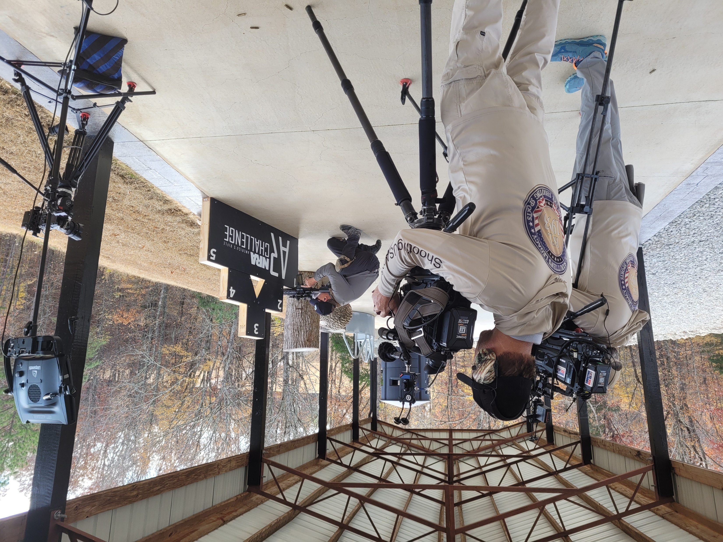
Videos are Coming Soon
A helpful series of full-length match and ARC-Tips training videos have been produced by the NRA and/or with the assistance of our ARC Brand Ambassadors, such as Kyle Lamb from Viking Tactics. These videos will soon be available to download directly from the ARC website and will be shared across NRA social media channels.

Slide 13
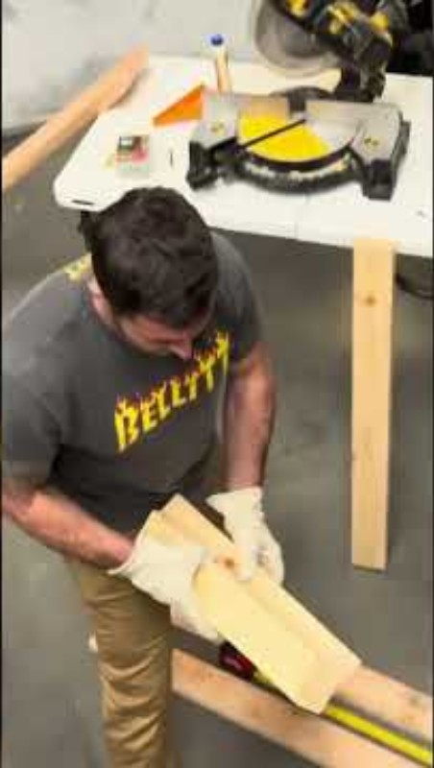
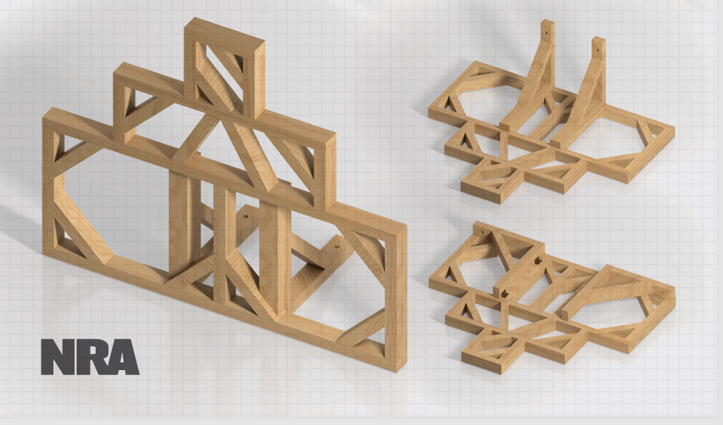

Build your Barricade
Click here: Official NRA ARC Building Plans
Please check your security settings if video doesn’t play “Click Here”

Slide 14


Next Steps
Visit https://ARC.NRA.org
Read through the FAQ’s at https://arc.nra.org/faq/
Download and review the full ARC Rulebook https://arc.nra.org/media/10359/arc-rulebook.pdf
For more information, email the ARC Program Manager Directly at: ARCINFO@nrahq.org or call: 703-267-1474

